Slide 1



Macedonian and Zagreb Stock Exchange 5 years later
Ohrid, September, 2024

Slide 2

Challenges ahead of us

Slide 3

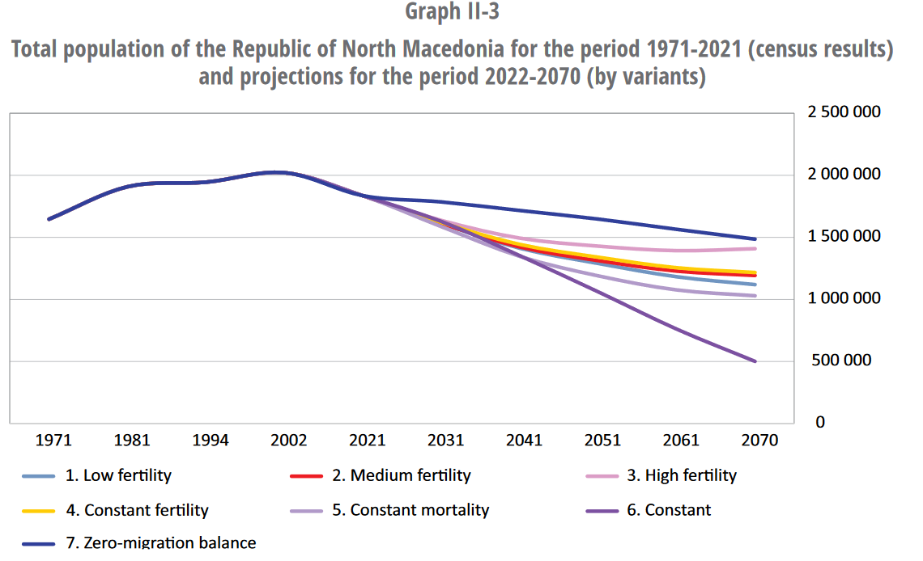
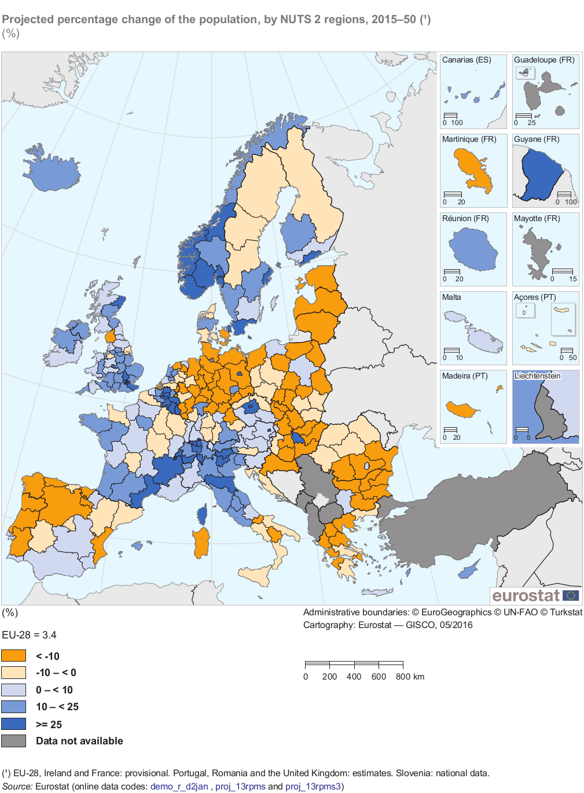
Global challenges: Demografic changes will drastically impact the society we live in.
*N. Macedonia State Statistical Office Report (2023)
*Eurostat baseline population projection for Croatia (2024)

Slide 4

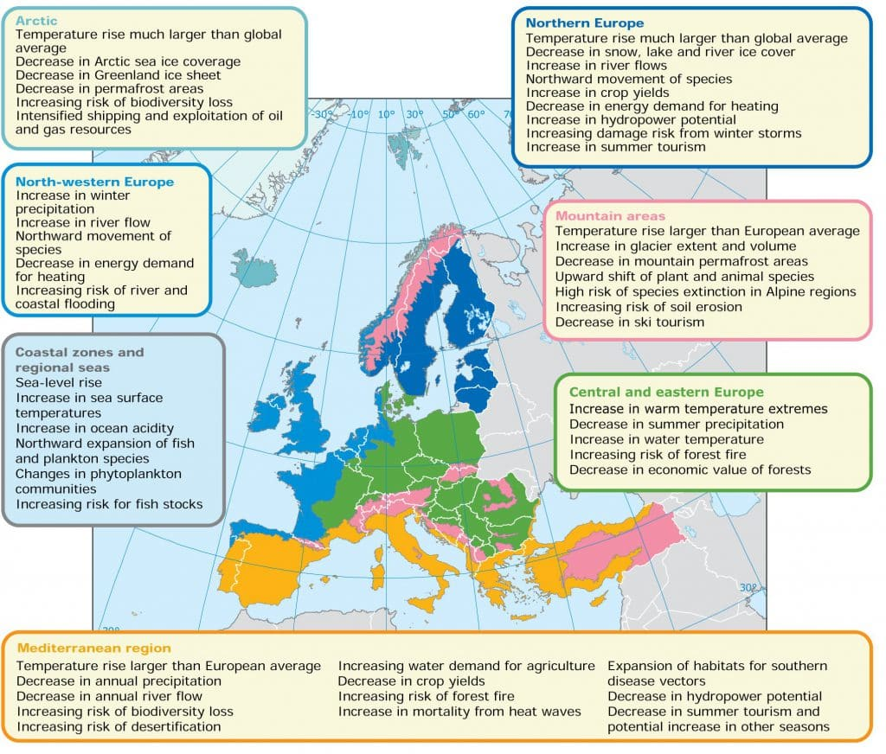
Environmental challenges: The world in which we live will not look the same.
Croatia relies on Tourism.
North Macedonia relies on agriculture.
Extreme weather conditions will influence the way we live, how long we live, earn, travel, how much electricity we consume.

Slide 5

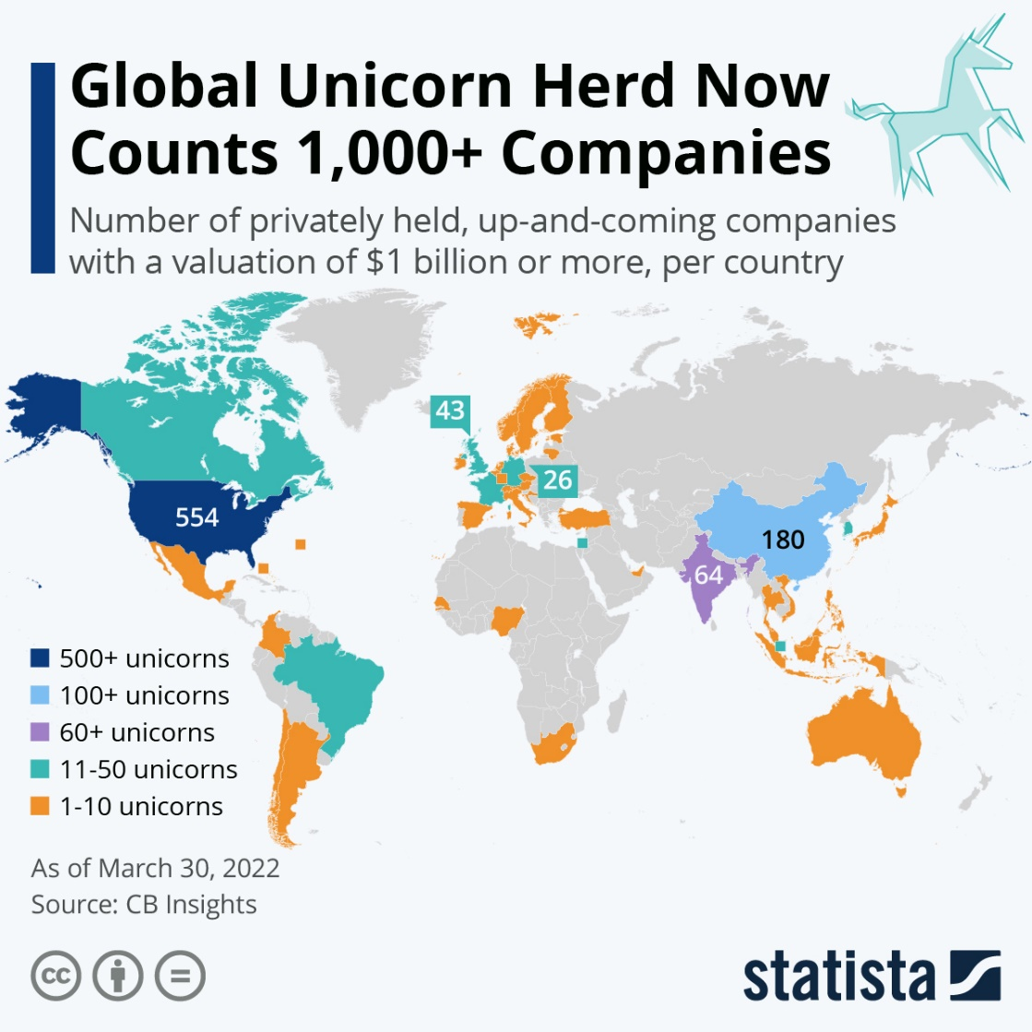
Financial markets challenges: Our early stage and innovation companies can not grow locally.
Lack of risk financing has caused large disproportion in distribution of unicorns (+1bn USD companies), and with that
Lack of technological companies in Europe
World wealth is channeled to US and is financing local innovation, emplyoment and growth
Seats of European companies moving to US to raise funds

Slide 6
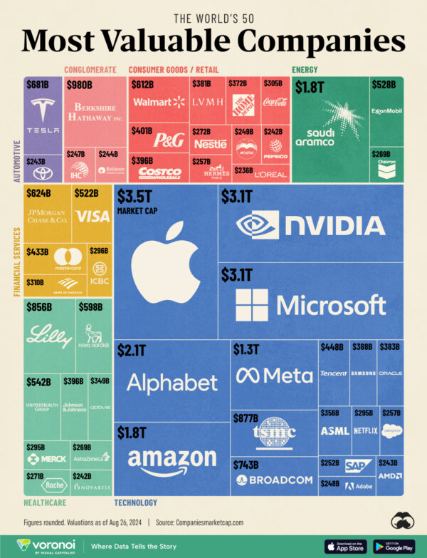
Financial markets challenges: US market cap leads all business categories
The US represents 50% of the global market capitalisation, dwarfing the EU’s 11%, driven by the attractiveness of the US listing and trading environment, dominated by Nasdaq and NYSE.
The situation is alarming: in 2021 alone, the US experienced more Tech IPOs than Europe did over the entire period from 2015 to 2023, and 50 European-founded companies have filed for an IPO in the US since 2018.

Slide 7
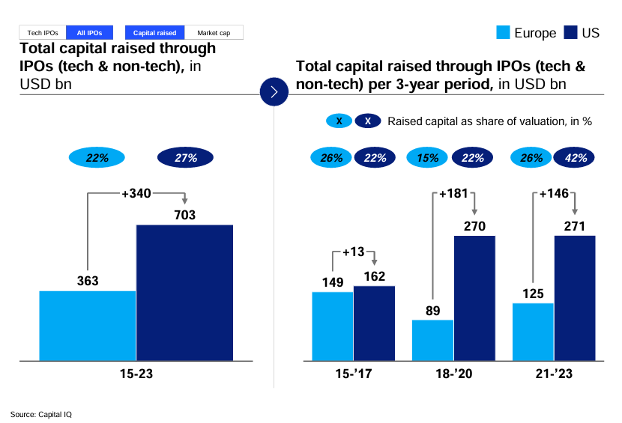
Financial markets challenges: Lack of IPOs

Slide 8
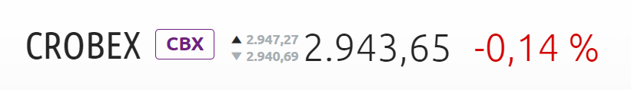
CROBEX ® challenge: 3000 points in 2008 and now
2008
2024
Composition (07/2008)
30 listed companies
Turnover (07/2008)
1.210.011.837,44 €
Market cap. (on 31.07.2008.)
18.582.636.178,03 €
Volume (07/2008)
11.341.565,00
Composition (07/2024)
21 listed companies
Turnover (07/2024)
153.225.565,14 €
Market cap. (on 31.07.2024.)
16.043.860.252,40 €
Volume (07/2024)
7.019.878,00

Slide 9
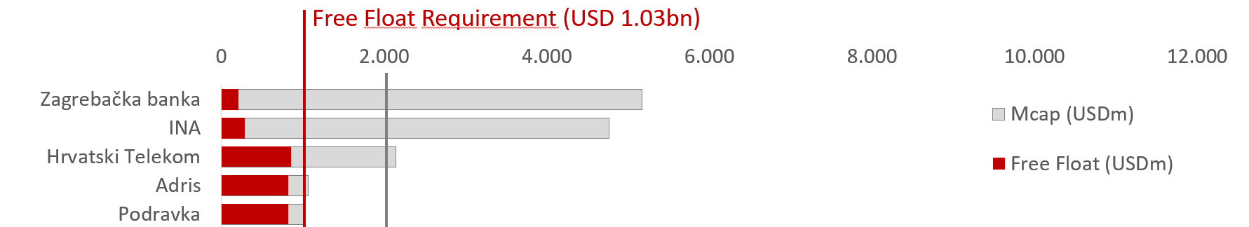
CROBEX® composition (2008 vs. 2024)
Out of the 30 companies comprising the CROBEX index in 2008:
11 were delisted by 2024
2 comprise other indices
6 no longer meet criteria for index composition
Market cap is about 14% lower, while turnover is about 13% of it used to be in 2008--> very low free float is the biggest problem of Croatian market

Slide 10
What do we need to do?

Slide 11


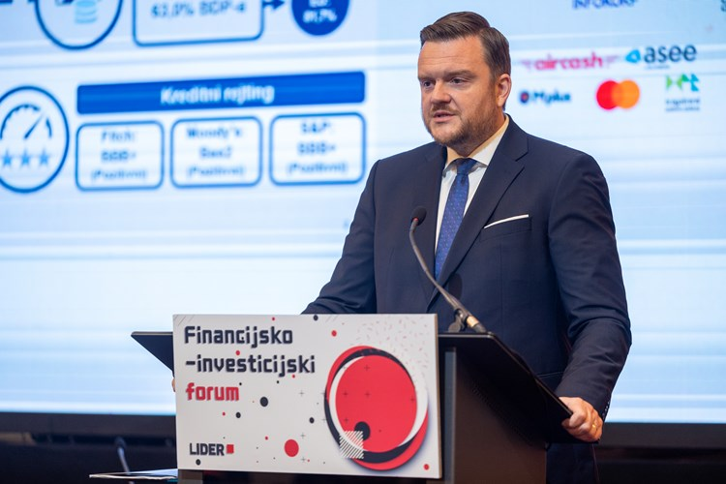
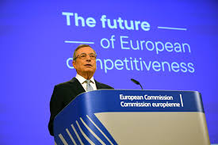
Capital Market Union: Dream, utopia or future?
CMU was launched in 2014:
The Goal: By increasing the range of investments opportunities, a CMU objective is to improve the capital markets effectiveness.
Marko Primorac
(06/2024), Croatian Minister of Finance:
We need to activate 37 bn of deposits of Croatian citizens in the banks.
CMU is key in mobilizing private investments needed for green and digital transition and other priorities of EU, including its competitiveness.
Mario Draghi (09/2024), former European Central Bank President and one of Europe's great economic minds:
In order to fund start-ups and scale-ups, supporting innovation and high-tech projects, there needs to be a “significant increase” in available equity and debt funding, he stated. To do so, occupational and private pension systems in EU member states need to be strengthened.

Slide 12

We all agree about the problems….
Investors
Issuers
Regulation
Lack of liquidity.
Low level of financial literacy.
Lack of new issuances.
Overreliance on banks.
Regulatory tsunami.
Gold plating.
Members
Trading
Environment
Very fast decrease in number of members.
Lack of remote members.
Flow of funds to less regulated assets (US tech stocks, Crypto, global online brokers).
Capital Gain and dividend tax, Increasing costs of technology and compliance.

Slide 13
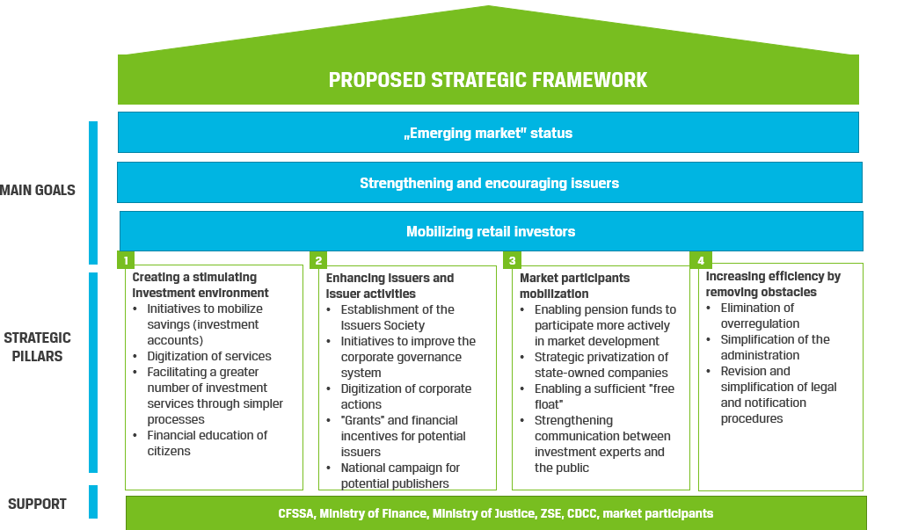
How about the solutions?
Source: CFA Croatia Society, Proposed strategic framework for Capital Market Development 01/2024

Slide 14

Future Challenges of Our Exchanges
Investors
Issuers
Regulation
Increase savings and investment of aging population.
Decrease dependency of our economies on the banks in order to enhance growth of the companies
Disproportional cost of reporting in comparison to other costs.
XBRL, Non financial reporting…
Members
Trading
Environment
Stronger activity of brokers that need to be opened to new technologies and financial products.
Market making, ETFs.
Make trade/settle cycle shorter and cheaper.
T+1, CCP, Cross border trading,
On line platforms.
More complexity in terms of legislation and technology, Cyber threats, New unregulated asset classes.
„Do we need small markets at all?”

Slide 15


5 years of MSE and ZSE
MSE, as market and organization, has a very high level of professionalism and readiness to innovate.
Huge potential for growth in the EU accession processes.
Transfer of knowledge: IR and market making education, why to list in Bum Club, MIFID II implementation.
Bringing our economies together.
Strong support for vertical integration.
Readiness of local regulator to support changes.
High entry barriers for foreign investors.

Slide 16












Useful links
MACEDONIAN STOCK EXCHANGE
Zagreb Stock Exchange Events

Slide 17

Thank you!
Zagreb Stock Exchange
ivana.gazic@zse.hr
tel: +38514686801

